Slide 1

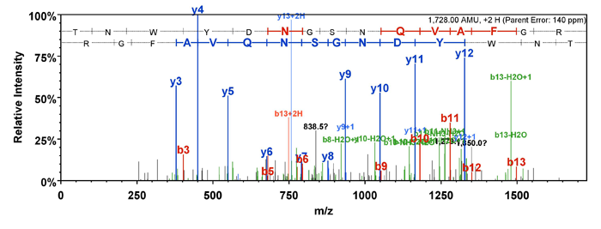
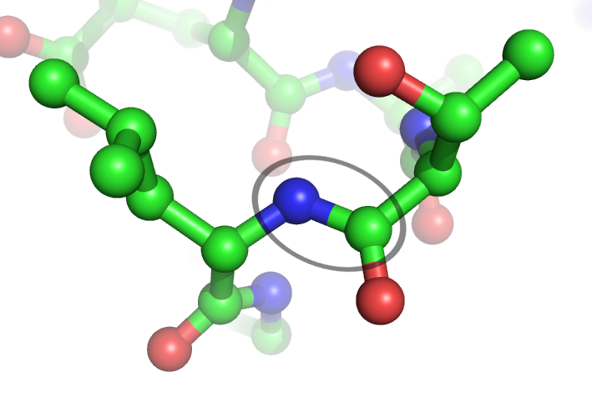
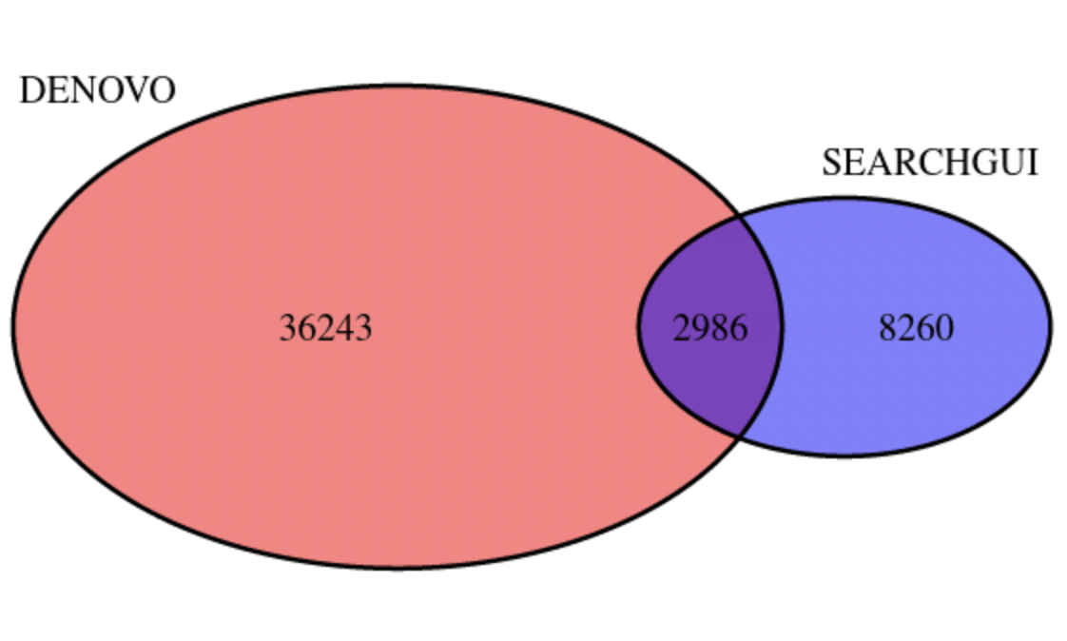
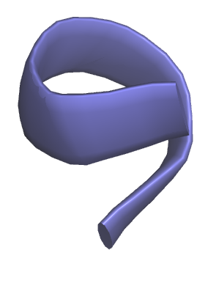
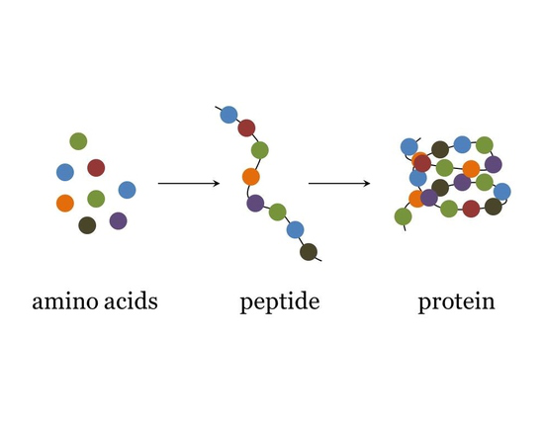

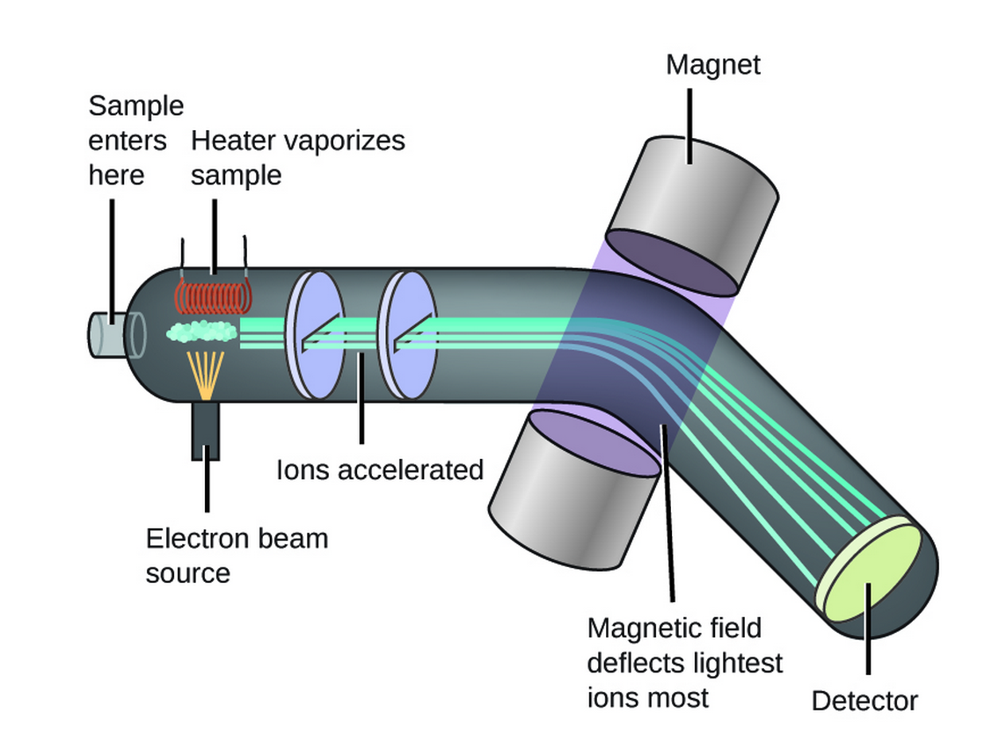

EVALUATION OF BIOINFORMATICS
Tri Nguyen
Mentor: Jamie Canderan
Abstract
Mass spectrometry
Results
PepNet is the software tool utilizing CNN to extract the peptides from spectra and much faster comparing to the conventional database.
Project is designed to find out how PepNet compares to the ordinary tools in terms of accuracy using a synthetic database of 8 bacterial species.
Project using Python to extract the data and using algorithms to count the values of 2 datasets
R programming to visualize the Venn diagram of matching proteins
Compare the theoretical sequence and SEARCHGUI to evaluate the scores.
PepNet has programmed to find Denovo datasets to have more peptides than the conventional SEARCHGUI datasets.
Mass spectrometry is a two-step software tool to extract the sample by using 2 or more spectrometers.
MS/MS compare the mass-to-charge (m/z) to the of different ions are y and b.
y9 to y10 is the range for detecting the amino acids.
MS/MS created the peptide sequence tag to determine the peptide in the protein database
Introduction
Amino acid are organic compounds that use to produce the proteins
Peptide are amino acids connected to each other by the chemical bonds
Protein are 3D structure and consist of 20 different amino acids to form up. Proteins have many functions in body from transport, enzyme and antibodies.
Methodology
Carbonate is IU supercomputer allowing to access the PepNet tool and downloading files of peptides. Using slurm to queue the dataset in the system.
Carbonate (IU Supercomputer)
Future Improvements
PepNet is the Convolutional Neural Network for creating accurate the peptide sequence with the confidence level. Using PepNet denovo tool to creating a new dataset of Peptide
Increasing the PepNet accuracy since the confidence level are still low.
Comparing more datasets and improve the results.
PepNet Denovo
Mass spectrometry is an analytical tool to gauge the mass-to-charge(m/z) the molecules. It can be used to measure exact weight of molecule.
Using Python to analyze the dataset and put them in dictionary. Then utilizing counting algorithm to find matching peptides from two datasets SEARCHGUI and PeptideShaker.
Acknowledgements
Thanks to PhD student Jamie Canderan for helping and guiding my first undergraduate research.
Indiana University Carbonate Supercomputer
PepNet: A Fully Convolutional Neural Network for De Novo Peptide Sequencing. Indiana University, https://assets.researchsquare.com/files/rs-1341615/v1_covered.pdf?c=1645108424.
R Programming to visualize the Venn diagram of matching proteins from 2 datasets.
.

